Slide 1

THE BREAKTHROUGH EXPLAINED
Attention is All You Need:
A Revolutionary Breakthrough in NLP
Vaswani et al. (2017)

Slide 2

Introduction
Background on sequence-to-sequence models
Limitations of RNNs and CNNs
Translation, summarization, question-answering, etc.
Difficulty in capturing long-range dependencies
Traditionally used RNNs and CNNs
Sequential nature slows down training

Slide 3

Motivation
Need for a new architecture
Address limitations of RNNs and CNNs
Improve training efficiency
Advantages of the attention mechanism
Better capturing of long-range dependencies
Enables parallel processing

Slide 4
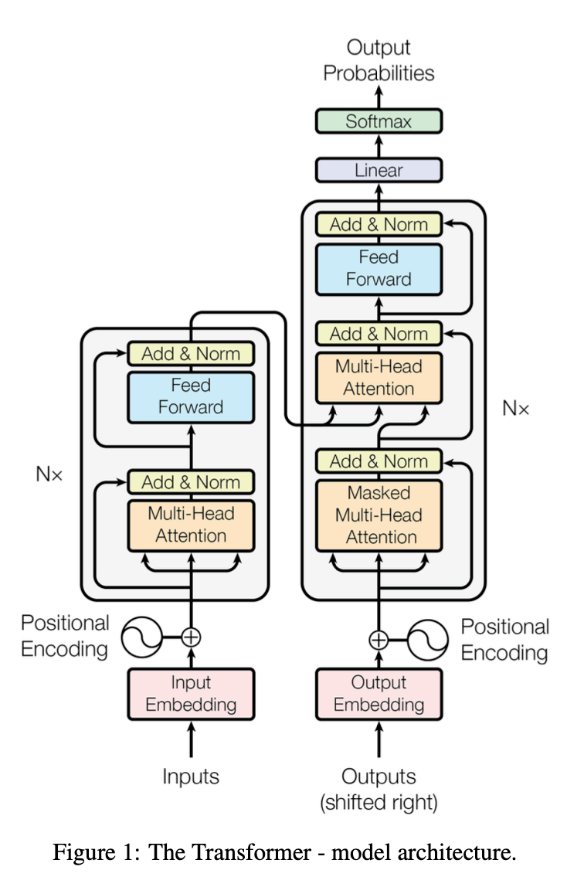
Transformer Architecture
Encoder-decoder structure
Multi-layered encoder and decoder
Components:
Self-attention: Captures relationships between words in a sequence
Multi-head attention: Learns different types of relationships
Positional encoding: Provides information about the position of words

Slide 5

Experimental Setup
Datasets
WMT 2014 English-to-German
WMT 2014 English-to-French
Training process
Optimized hyperparameters
Regularization techniques (e.g., layer normalization, dropout)
Evaluation metrics
BLEU scores

Slide 6
Results
Performance of the Transformer model
Demonstrated effectiveness in terms of:
Improved BLEU scores compared to state-of-the-art models
Faster training time
Translation quality
Speed

Slide 7

Main contributions
Introduced the Transformer architecture
Demonstrated the power of the attention mechanism
Potential impact on future NLP research
Foundation for a wide range of NLP models and applications
Inspires further development of attention-based methods
Conclusion

Slide 8

Do you have
any questions?
I will be happy to answer.

